Slide 1
What is Data Center?
A data center is a facility that centralizes an organization’s shared IT operations and equipment for the purposes of storing, processing, and disseminating data and applications.
It is the department in an enterprise that houses and maintains back-end IT systems and data stores — its mainframes, servers and databases.
In the days of large, centralized IT operations, this department and all the systems resided in one physical place, hence the name data center.
A Data Center in the Cloud.
A Cloud Data Center is just like a traditional data center except that the cloud services provider is an expert vendor who is providing all the needed services and support.
The client organization outsources the functions that would have been done in-house to the service provider.

Slide 2
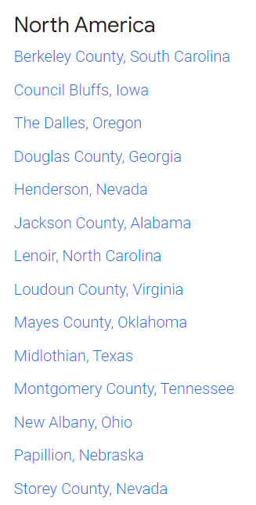
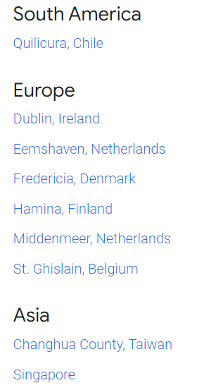
Google Data Center Locations
Google owns and operates data centers all over the world, helping to keep the internet humming 24/7.

Slide 3
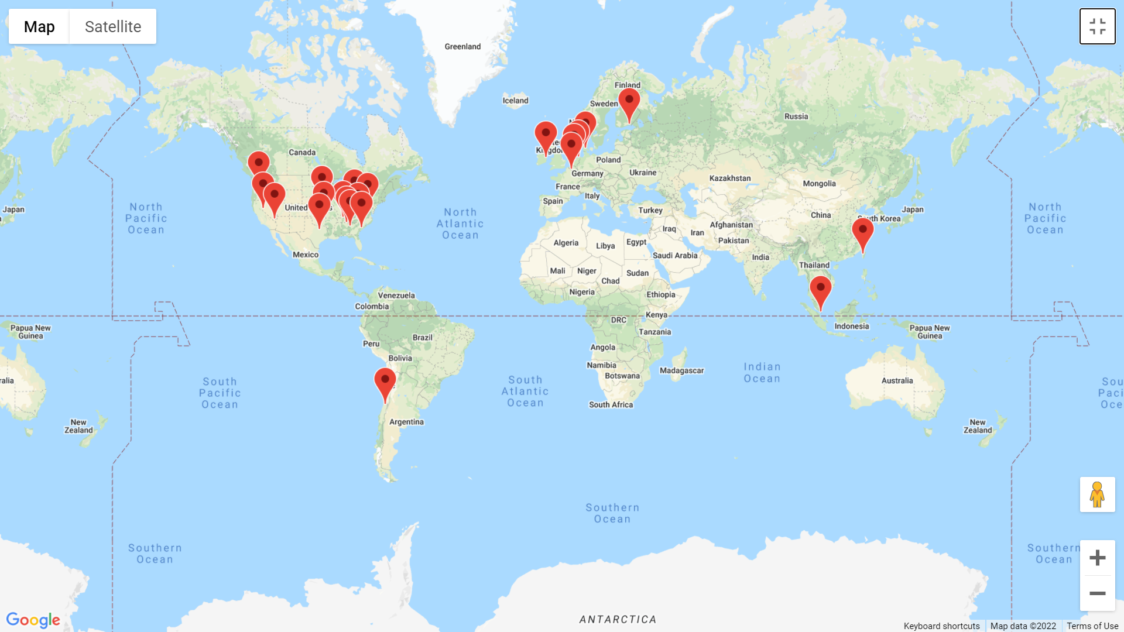
Google Data Center Locations -

Slide 4
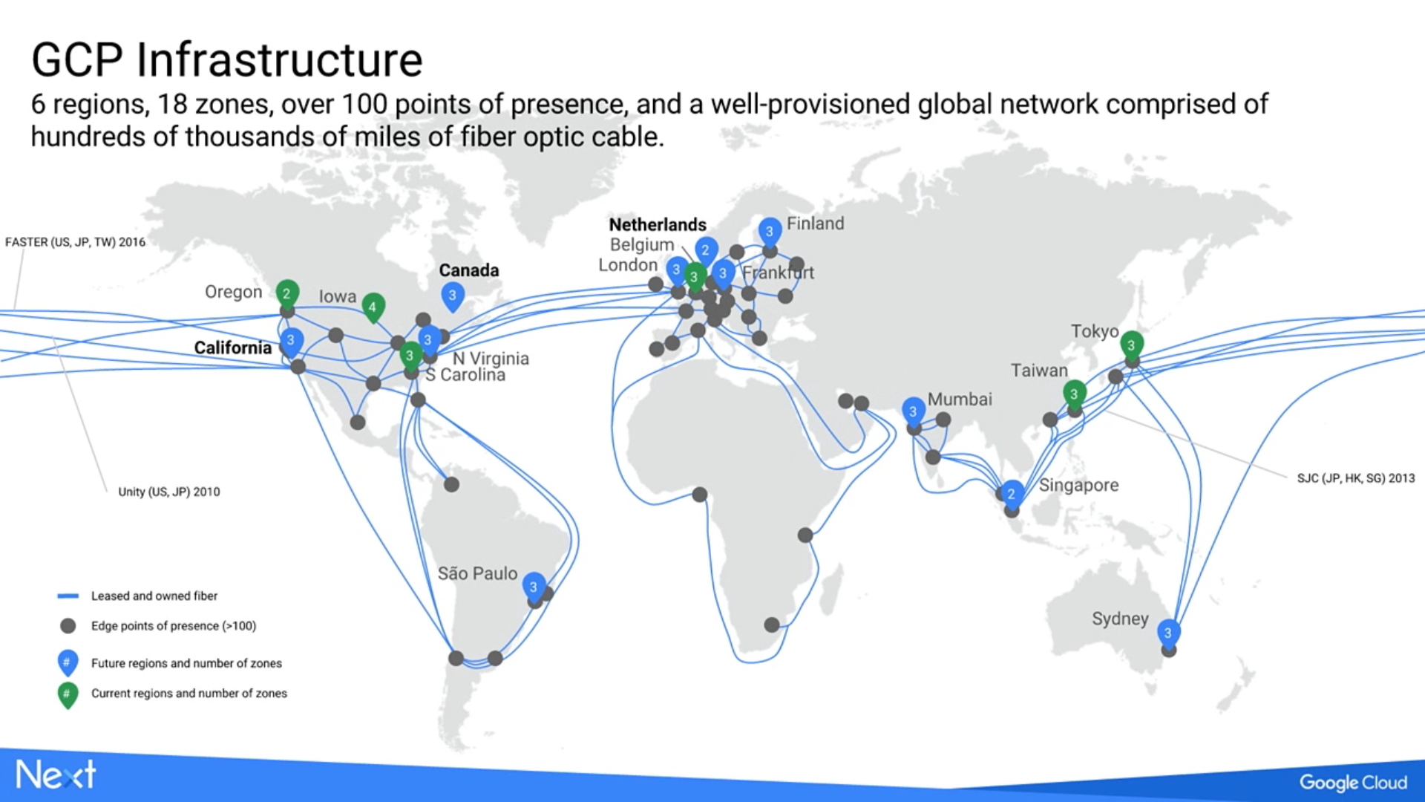
Where are Google’s Cloud data centers?
Google has several cloud data centers throughout the world and is bringing more online in 2017. In addition to data centers in the Western US, Central US, Eastern US, Western Europe, and Eastern Asia, the company announced that new “cloud regions” will come online in 2017 in Frankfurt, London, Mumbai, Singapore, Sydney, and Sao Paulo, and in undisclosed areas in Finland, California, The Netherlands, and Northern Virginia.
Google has several cloud data centers throughout the world and is bringing more online in 2017. In addition to data centers in the Western US, Central US, Eastern US, Western Europe, and Eastern Asia, the company announced that new “cloud regions” will come online in 2017 in Frankfurt, London, Mumbai, Singapore, Sydney, and Sao Paulo, and in undisclosed areas in Finland, California, The Netherlands, and Northern Virginia.

Slide 5
How it Started..
The original hardware (circa 1998) that was used by Google when it was located at Stanford University included:
Sun Microsystems Ultra II with dual 200 MHz processors, and 256 MB of RAM. This was the main machine for the original Backrub system.
2 × 300 MHz dual Pentium II servers donated by Intel, they included 512 MB of RAM and 10 × 9 GB hard drives between the two. It was on these that the main search ran.
F50 IBM RS/6000 donated by IBM, included 4 processors, 512 MB of memory and 8 × 9 GB hard disk drives.
Two additional boxes included 3 × 9 GB hard drives and 6 x 4 GB hard disk drives respectively (the original storage for Backrub). These were attached to the Sun Ultra II.
SDD disk expansion box with another 8 × 9 GB hard disk drives donated by IBM.
Homemade disk box which contained 10 × 9 GB SCSI hard disk drives.

Slide 6
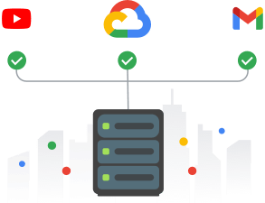
Google at Glance
Google Mission: to organize the world’s information and make it universally accessible and useful
Established in (September 4, 1998)
Today Google runs over one million servers in centers around the world
Processes over one billion search requests and twenty petabyte (1015 B) of user-generated data every day

Slide 7
The 6 Layers of Google Data Center Security
Layer 1: Signage and Fencing
Layer 2: Secure Perimeter
Layer 3: Building Access
Layer 4: Security Operations Center
Layer 5: Data Center Floor
Layer 6: Secure Hard Drive Destruction

